Slide 1

Laravel Notes www.codehafeez.com

Slide 2
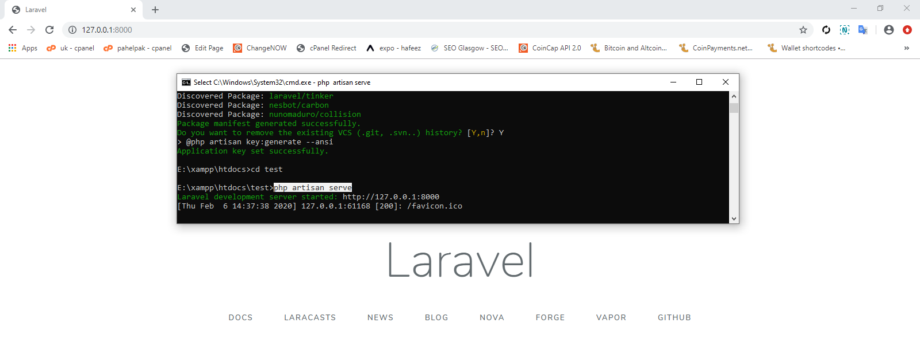
How to Install
Download & Install Composer
Run these commands in RUN xamp dir.
composer create-project laravel/laravel –-prefer-dist
composer create-project laravel/laravel test dev-develop
test (dir. cmd run) => php artisan serve

Slide 3
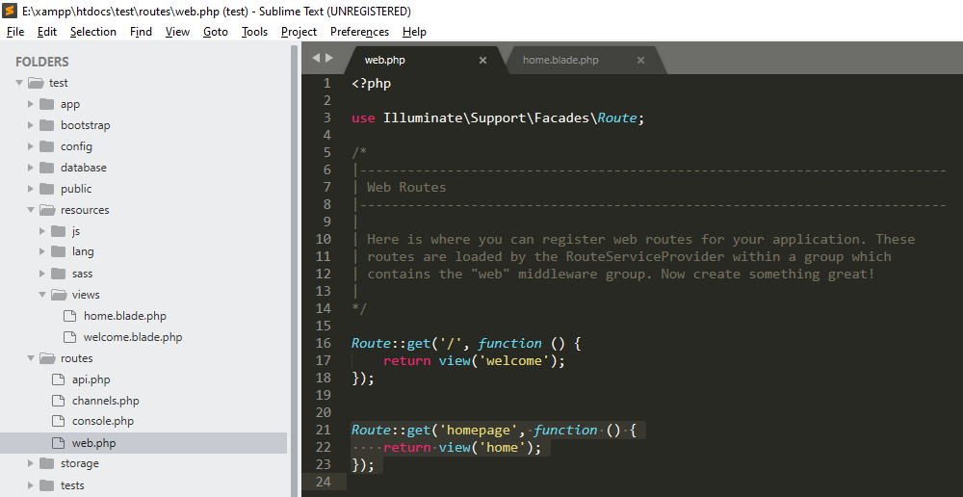

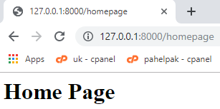
Create New Page

Slide 4
composer create-project laravel/laravel HafeezEx dev-develop
cd HafeezEx
composer install
npm install
php artisan serve
// Create Controller
php artisan make:controller TicketController
php artisan make:model Ticket
// Create Model
php artisan make:model Contact –migration
php artisan migrate

Slide 5
Migration
public function up()
{
Schema::create('contacts', function (Blueprint $table) {
$table->increments('id');
$table->timestamps();
$table->string('first_name');
$table->string('last_name');
$table->string('email');
$table->string('job_title');
$table->string('city');
$table->string('country');
});
}

Slide 6
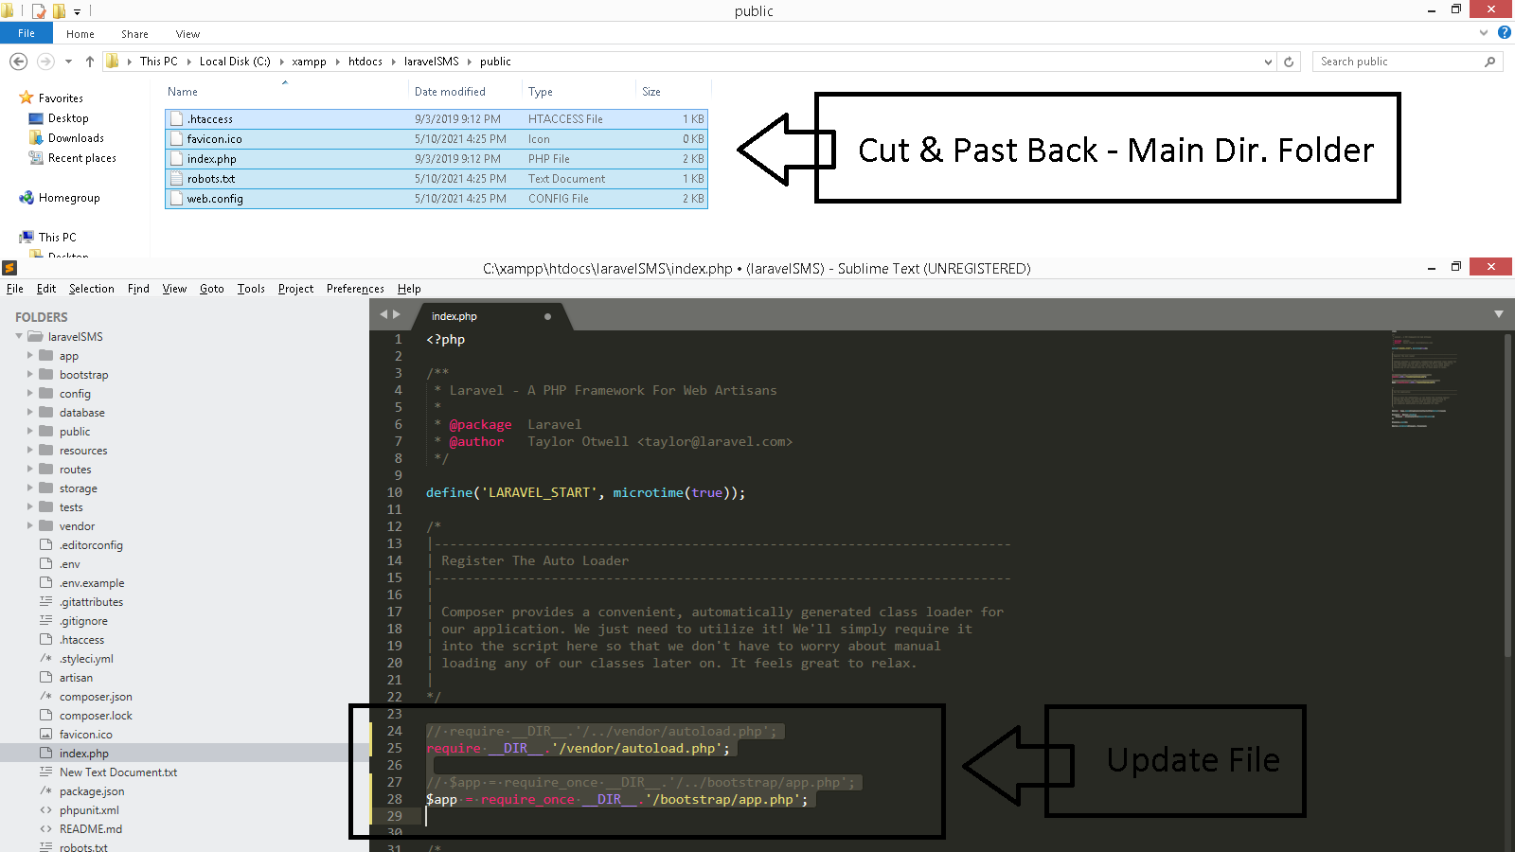
Remove Public Folder

